Slide 1
HERBERT Autonomous Rubik’s Cube Solver
Dylan Lytle
Li Lao
Matt Frandsen
Jon Whitaker

Slide 2
What inspires you?
CubeStormer1 & 3 – Fastest robot to solve a Rubik’s Cube (3.253s) [1].
Zackary Gromko – Claims a new record on October 15, 2015 (2.39s) [2].
https://youtu.be/X0pFZG7j5cE
https://youtu.be/bEiQwmEe45s?t=13s
Notes:
Jon

Slide 3
Introduction
GOAL: Create an autonomous robotic Rubik's Cube solver.
Integrates various technologies
Video cameras, stepper motors, mechanical actuators, single-board computer, FPGA
Possibly overtake Guinness World Record (3.253s at the time)
Optimize mechanical and image processing operations while maintaining the precision needed to solve the cube.
Notes:
Jon

Slide 4
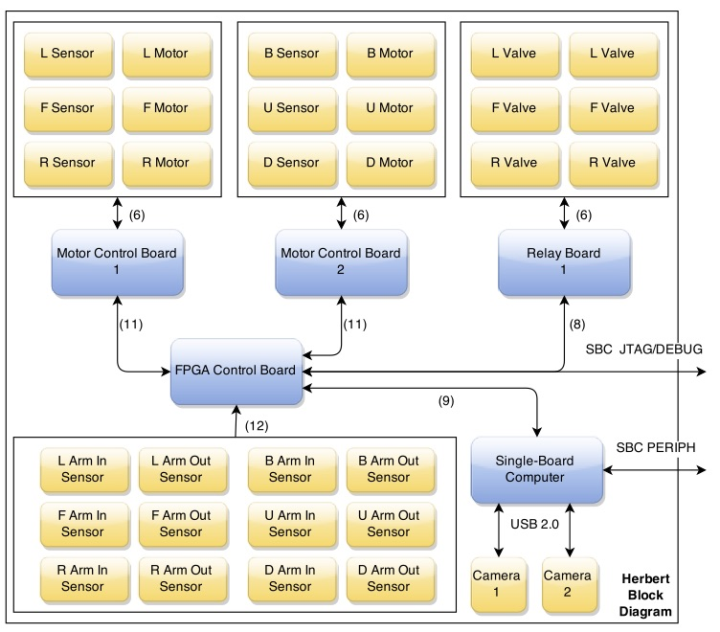
High level System Diagram
Notes:
Jon

Slide 5
OpenCV & Image Processing
Notes:
Li

Slide 6
OpenCV & Image Processing
Original Plan
Two cameras, one for three of the six faces of the cube.
Grayscale conversion – Convert RGB to pixel intensity for feature filtration [3].
Canny edge detection - Identify the edges of the cube and the faces [4].
Contour filtering - Identify cubelets on each face [5].
Notes:
Li

Slide 7
OpenCV & Image Processing
Final Implementation
One camera
Static mask
Notes:
Li

Slide 8
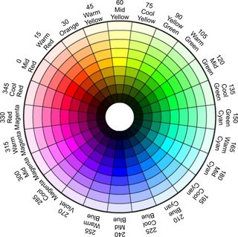
Opencv and Image PRocessing
HSV conversion – Convert RGB to HSV [3].
HSV characterization – Use pixel histogram and bin each facelet (square) [6].
Histogram optimization

Slide 9
Kcube & Solution Sequence
Cubelets represented with an ASCII character
‘W’, ‘R’, ‘B’, ‘G’, ‘O’, ‘Y’
Kcube application used to generate the solution sequence [5].
Created by Greg Schmidt
Utilizes Kociemba’s algorithm
Microsoft Windows [ Version X.X. XXX ]
Copyright (c) 2015 Microsoft Corporation . All rights reserved .
c:> kcube L: GGWWOWBRB F: GWGBGYWBO U: YOOOWYROY D: ORGWYYYRB R: OGBBRYWRR B: YBROBGWGR
Notes:
Jon

Slide 10
Mechanical Actuators
Notes:
Dylan

Slide 11
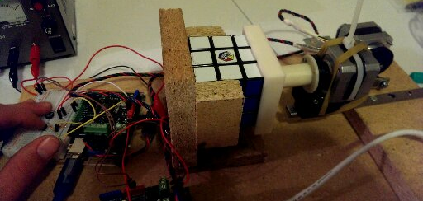
Mechanical Actuators
One arm for each face
Improvement over 4 arms solutions
Each arm actuates, avoiding contact with the other arms
Original Ideas
Rotary → Linear motion
Linear actuator motor
Notes:
Dylan

Slide 12
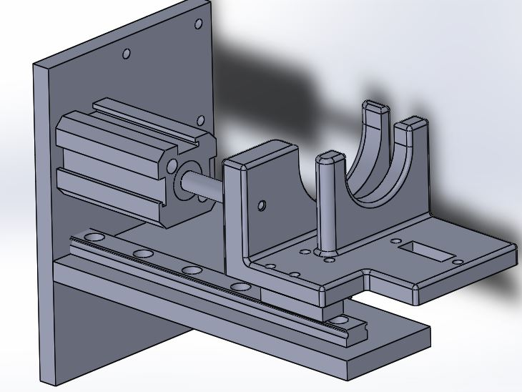
Mechanical Actuators
Final Implementation
Double action pneumatic air cylinder
High Speed
Affordable
Small footprint
Controlled by solenoid valve and a relay board
Simultaneous coaxial pair motion
Approximately 40-60psi
Notes:
Dylan

Slide 13
Electro-Mechanical Stepper Motors

Slide 14
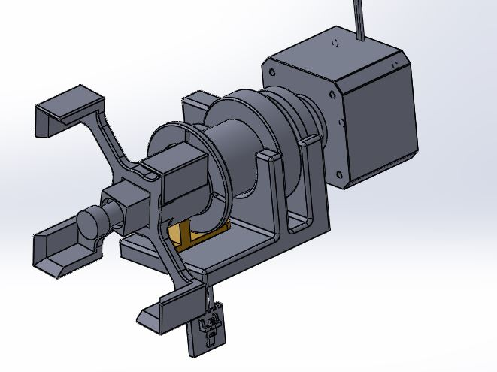
Electro-Mechanical Stepper Motors
Each actuating arm has a stepper motor to rotate each face
90/180 degree rotations clockwise or counter-clockwise
Controlled by an FPGA and proprietary motor control board
Full steps, no micro-stepping
Break sensor for 90 degree
alignment
Notes:
Matt

Slide 15
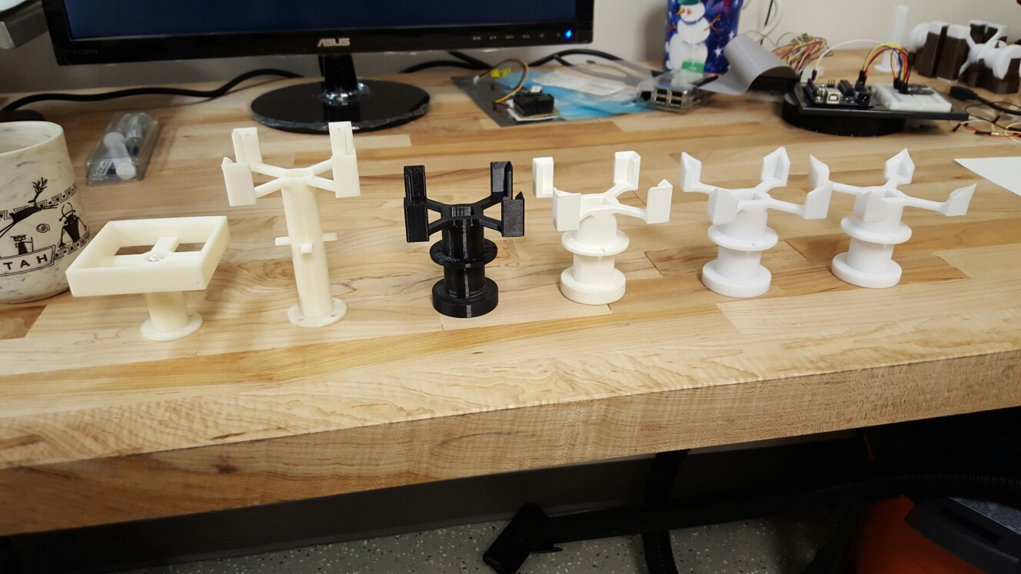
Electro-Mechanical Stepper Motors
Progression of Arm Pieces
Notes:
Matt

Slide 16
Challenges
Implementing & Synchronizing a system with 6 arm assemblies
System integration
Construction & Component acquisition
Image processing
ROI issues
Color characterization (lighting)
Team scheduling
Notes:
Jon

Slide 17
Summary
Integrates various technologies and domains of engineering.
Computer and Electrical engineering combined with mechatronics and robotics
Overcame many challenges
Great application of system integration and teamwork.
Notes:
Jon

Slide 18



Acknowledgments
Point Grey Research
BioFire Defense
Futura Industries

Slide 19
REFERENCES
[1] Guinness World Records. Fastest robot to solve a Rubik's Cube [Online]. Available: http://www.guinnessworldrecords.com/world-records/fastest-robot-to-solve-a-rubiks-cub
[2] Guinness World Records. Robot created by American student solves a Rubik’s cube in just 2.39 seconds [Online]. Available: http://www.guinnessworldrecords.com/news/2015/11/robot-created-by-american-student-solves-a-rubiks-cube-in-just-2-39-seconds
[3] OpenCV Developers Team. Miscellaneous Image Transformations [Online].
Available: http://docs.opencv.org/modules/imgproc/doc/miscellaneous_transformations.html#cvtcolor
[4] OpenCV Developers Team. Feature Detection [Online]. Available: http://docs.opencv.org/modules/imgproc/doc/feature_detection.html?highlight=canny#canny
[5] OpenCV Developers Team. Structural Analysis and Shape Descriptors [Online]. Available: http://docs.opencv.org/modules/imgproc/doc/structural_analysis_and_shape_descriptors.html?highlight=findcontours#findcontours
[6] OpenCV Developers Team. Histograms in OpenCV [Online]. Available: http://opencv-python-tutroals.readthedocs.org/en/latest/py_tutorials/py_imgproc/py_histograms/py_histogram_begins/py_histogram_begins.html

